Slide 1

AI-Integrated Multi-Modal Academic Evaluation, Performance Intelligence, and Automated Viva Assessment System
R26-SE-025

Slide 2
AI-Integrated Multi-Modal Academic Evaluation, Performance Intelligence, and Automated Viva Assessment System
Panel Comments
Comments | What we have include
IT22262554 - | -
IT22134776 - | -
IT22557056 - | -
IT22239198 - Support Essey Type Questions too | The AI modal is being trained to evaluate Essey type questions

Slide 3
AI-Integrated Multi-Modal Academic Evaluation, Performance Intelligence, and Automated Viva Assessment System
Problem
  Time-consuming, inconsistent, and difficult to scale.
  Examiner fatigue, stress, and bias affect grading fairness.
  Delayed feedback.
Affected Groups
  Lecturers / Examiners
  Universities & Educational Institutes
  Students

Slide 4

IT22239198 | H.I.B Wickramarathne
AI-Driven Handwriting Parsing and evaluation Module​
Software Engineering

Slide 5
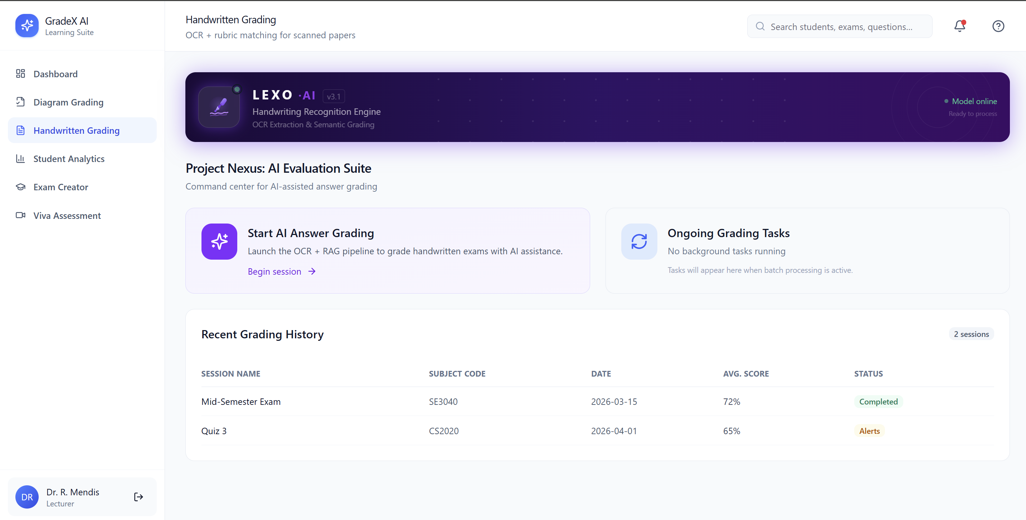
AI-Driven Handwriting Parsing and Evaluation Module
Solution
Handwritten Answer Parsing
Unified AI Evaluation Engine
Explainable AI (XAI) Feedback
Misconception Detection
Human-in-the-Loop

Slide 6
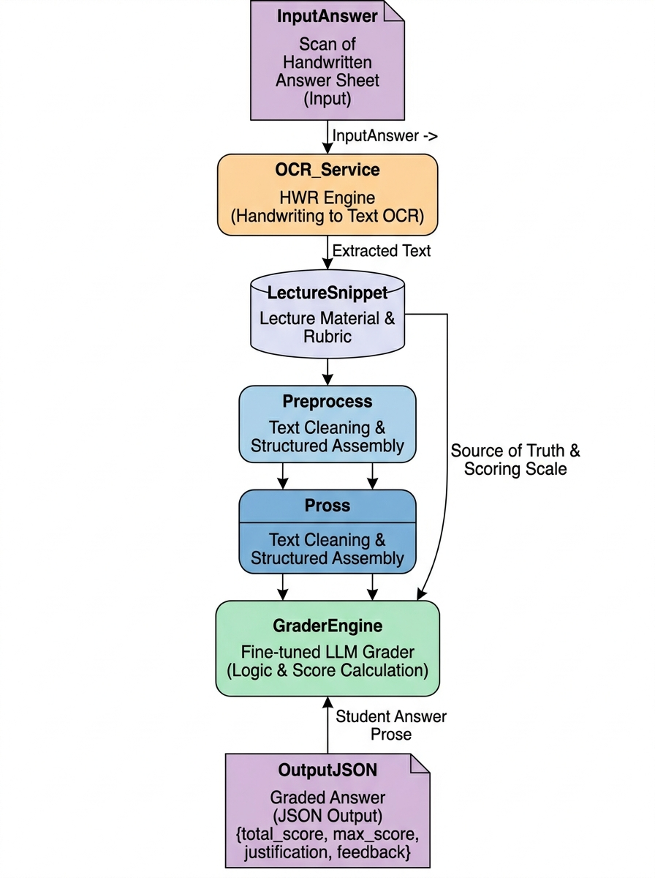
User Requirements
Neural OCR Handwriting Recognition
Semantic Rubric Alignment
Automated Scoring & Justification
Bias-Free Evaluation Logic
Dynamic Mark Scaling
Forensic Misconception Auditing
Structured JSON Data Export

Slide 7
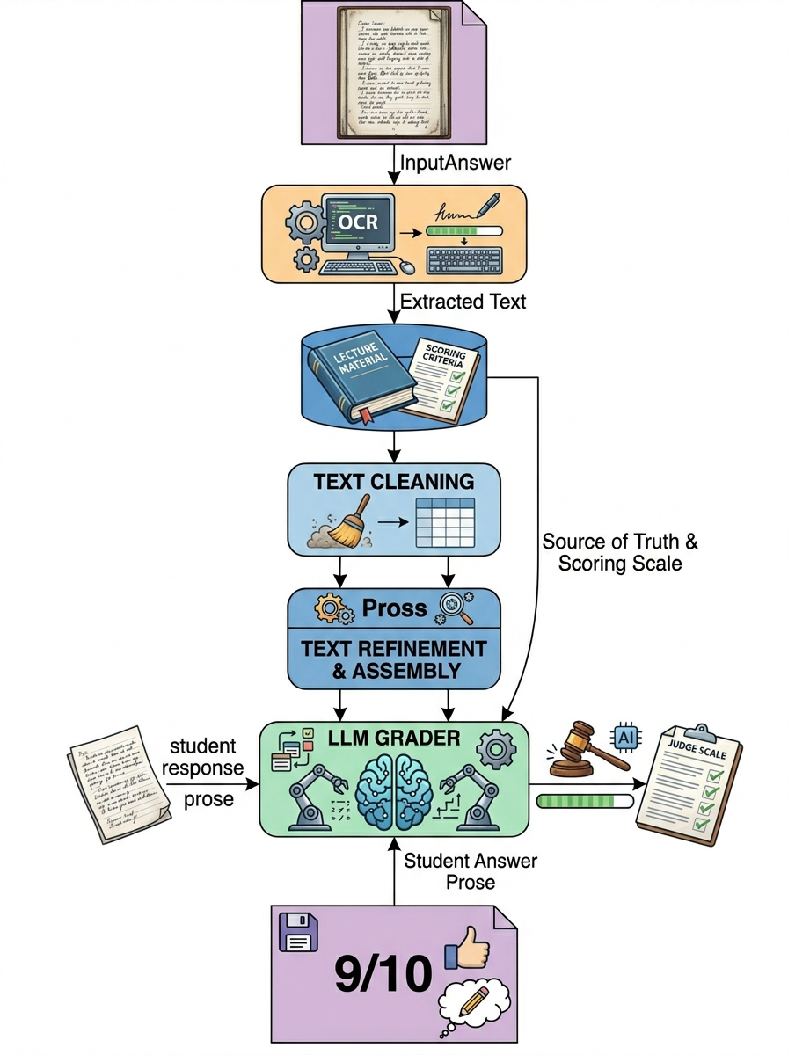
AI-Driven Handwriting Parsing and Evaluation Module
Design Excellence
Forensic Semantic Alignment
Cognitive Guardrails & Bias Mitigation
Error Tolerant OCR Pipeline
Explainable AI (XAI)
Deterministic Data Architecture

Slide 8

IT22262554 | Senarathna A.M
Handwritten ER Diagram Extraction and Evaluating Module
Software Engineering
IT22262554 | Senarathna A.M| R26-SE-025

Slide 9
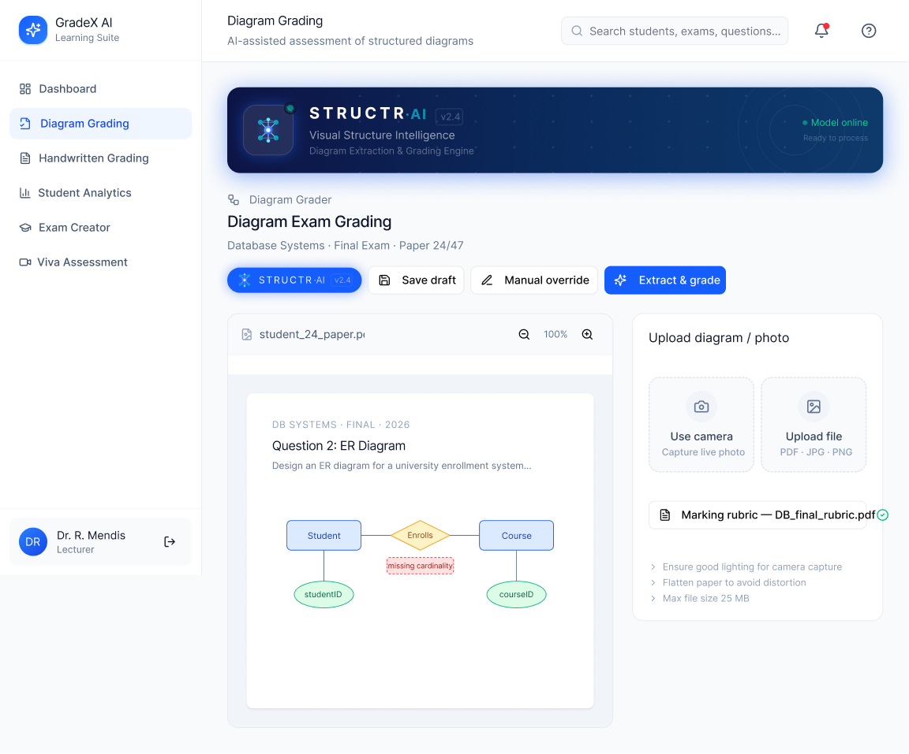
Handwritten ER Diagram Extraction and Evaluating Module
Solution
Uses a custom-trained YOLO-based object detection model to identify ER diagram
Integrates OCR models to recognize handwritten and printed text
Detects connecting lines between Objects
Reduces manual effort required by lecturers to mark ER diagrams.
Improves consistency and fairness in grading
Designed as a modular prototype
IT22262554 | Senarathna A.M| R26-SE-025

Slide 10
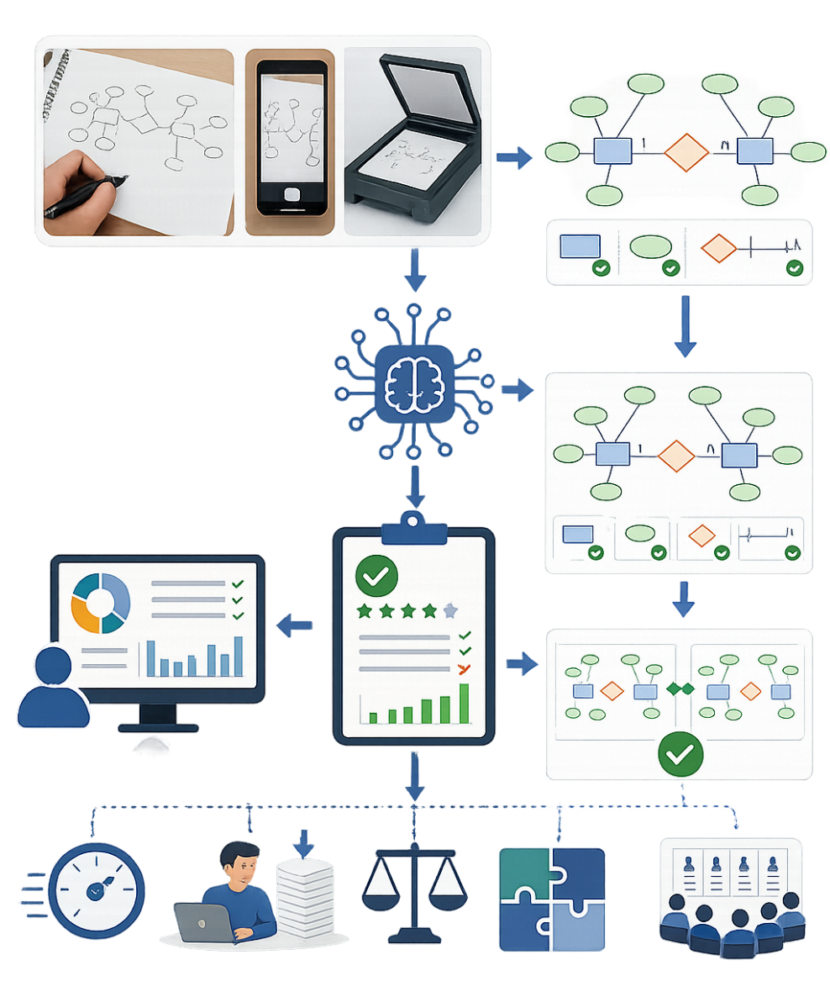
Handwritten ER Diagram Extraction and Evaluating Module
User Requirements
evaluate handwritten ER diagrams automatically
Recognition of diagram symbols and relationships
Faster generation of marks and feedback
Capability to process scanned images or uploaded diagram
Accurate identification of connections
IT22262554 | Senarathna A.M| R26-SE-025

Slide 11
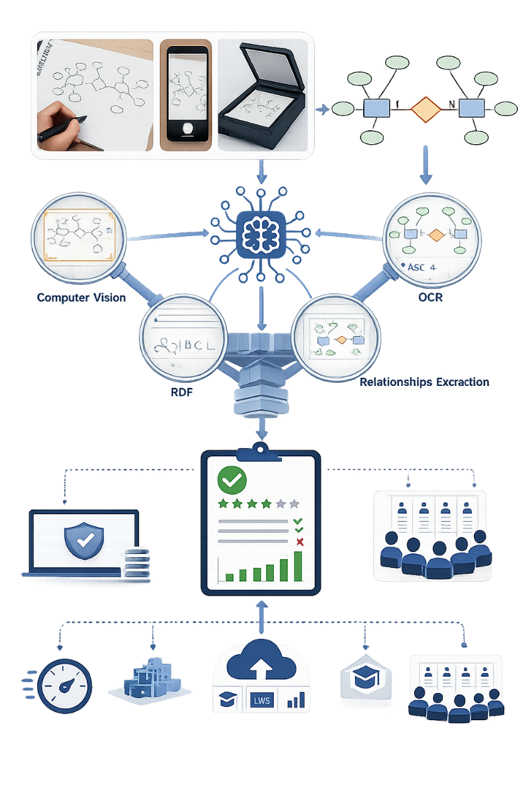
Handwritten ER Diagram Extraction and Evaluating Module
Design Excellence
Combines computer vision, OCR, and structural relationship analysis
Introduces automated semantic understanding
Uses deep learning object detection for higher adaptability
Supports both visual recognition and logical validation
practical applicability in real educational environments.
IT22262554 | Senarathna A.M| R26-SE-025

Slide 12

IT22134776 | L.S.B Hemarathne
AI-Driven Exam Question Analytics and Prediction Module​
Software Engineering
IT22134776 | L.S.B Hemarathne | RE26-SE-025

Slide 13
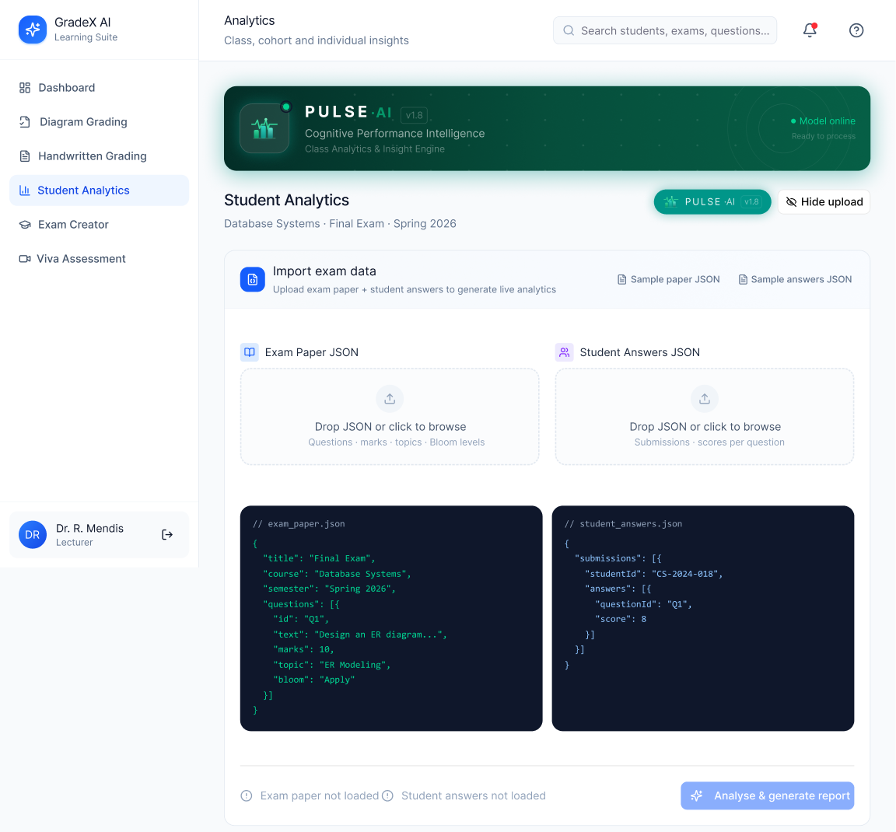
AI-Driven Exam Question Analytics and Prediction Module​
Solution
Analyzes historical exam papers to identify important topics and question patterns
Identifies weak concepts and learning gaps automatically
Provides predictive insights for future exam preparation
Detects frequently misunderstood questions
IT22134776 | L.S.B Hemarathne | RE26-SE-025

Slide 14

AI-Driven Exam Question Analytics and Prediction Module​
User Requirements
Analyze historical student performance data
Generate diagnostic reports identifying weak topics and cognitive skill gaps
Predict future exam questions based on pattern analysis
Visualize student performance analytics
Generate reports and insights for lecturers and students
IT22134776 | L.S.B Hemarathne | RE26-SE-025

Slide 15
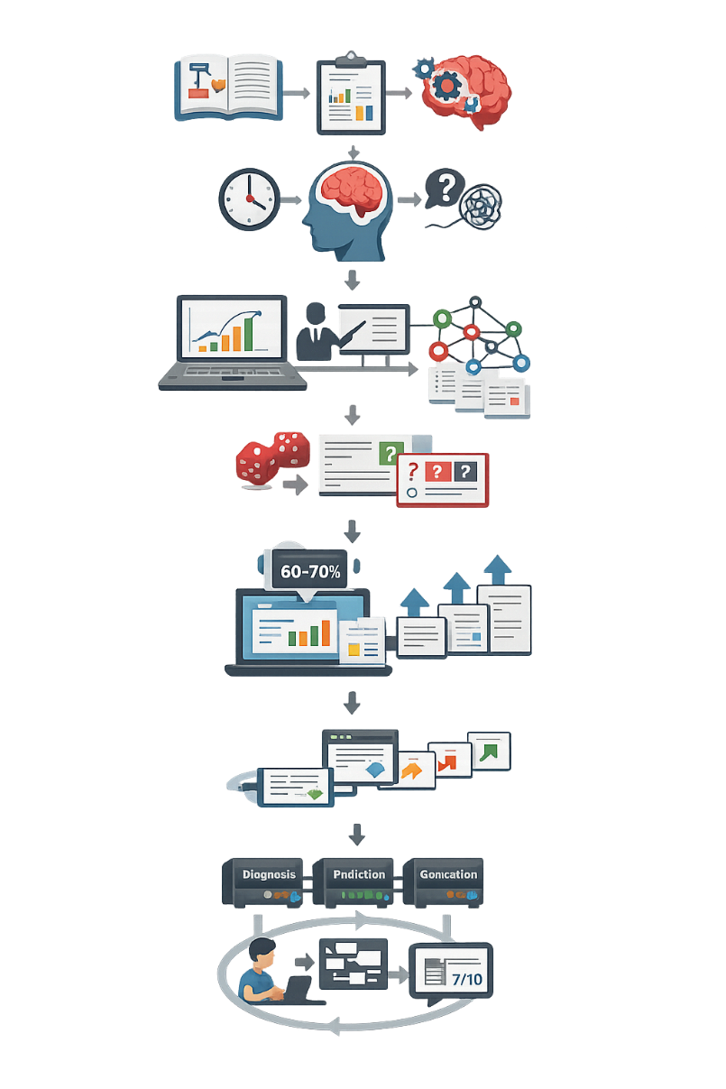
AI-Driven Exam Question Analytics and Prediction Module​
Design Excellence
Separates content knowledge from cognitive skill application
Combines Machine learning, and learning analytics in one platform
Provides question-level analytics instead of only final grade analysis
Supports data-driven educational decision making
Adaptive Question Generation Engine
IT22134776 | L.S.B Hemarathne | RE26-SE-025

Slide 16

IT22557056 | HERATH B.K.H.M.B.L
AI-Integrated Multi-Modal Viva Evaluation System
Software Engineering
IT22134776 | L.S.B Hemarathne | RE26-SE-025

Slide 17
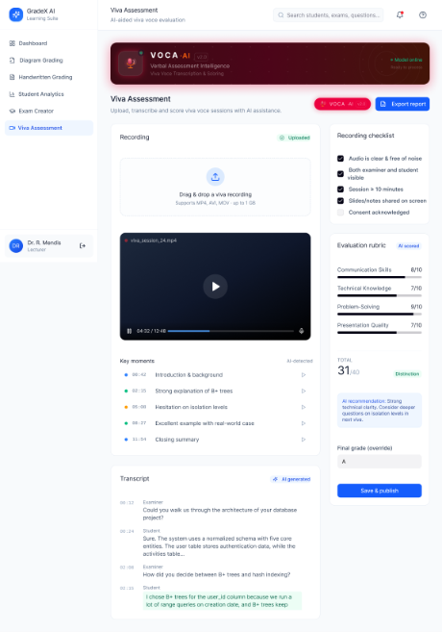
Solution
Continuous Frame-by-Frame Analysis
Automated Facial Emotion Detection
Detect Student Engagement and Attention
Confidence Prediction
Oral Emotion Recognition

Slide 18
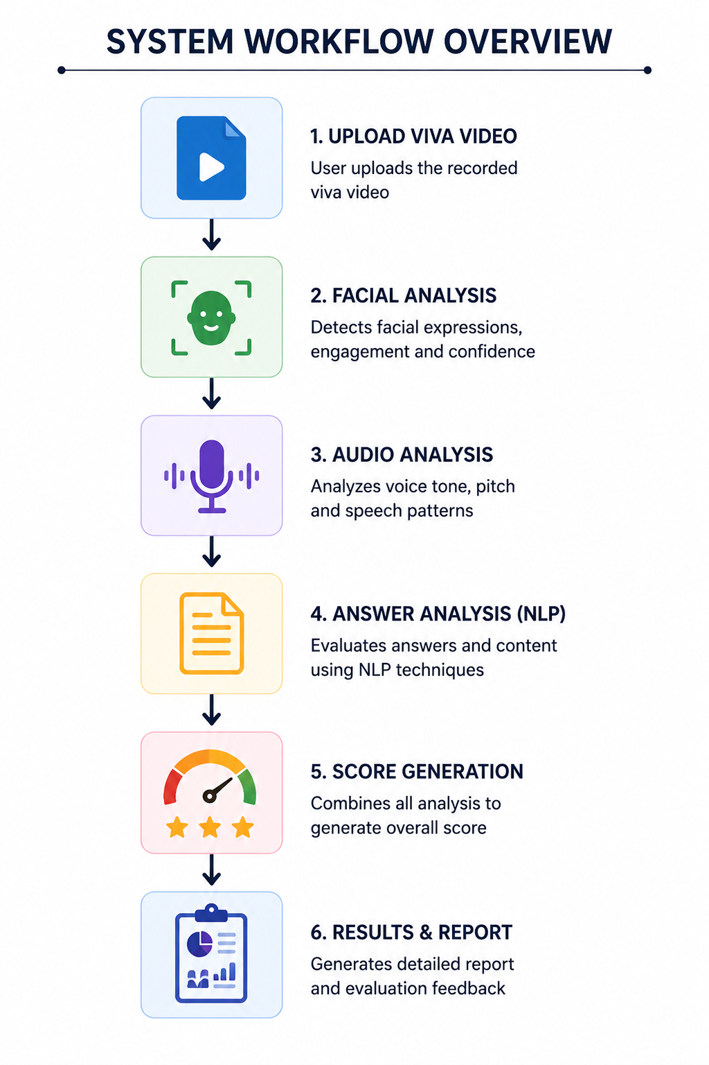
User Requirements
Analyze facial emotions, engagement confidence levels
Detect behavioral patterns such as nervousness, attentiveness, and interaction
Generate automated confidence and engagement scores
Provide objective and consistent viva evaluation support to reduce examiner bias
future AI model enhancements and analytics integration
Monitor detailed emotion timelines and behavioral insights
Upload and process recorded viva videos automatically

Slide 19

AI-Integrated Multi-Modal Viva Evaluation System
Design Excellence
Facial emotion, engagement, confidence analysis in one system
Uses AI and computer vision for automated viva evaluation
Performs continuous frame-by-frame behavioral analysis
Uses MediaPipe for accurate face detection and tracking
Applies deep learning models for emotion recognition
Supports future integration with audio and NLP modules
Suitable for real-world online viva assessment environments
IT22134776 | L.S.B Hemarathne | RE26-SE-025

Slide 20

AI-Integrated Multi-Modal Academic Evaluation, Performance Intelligence, and Automated Viva Assessment System
Primary Target Market
  Universities and higher education institutions.
  Online learning platforms and EdTech providers.
  Professional certification organizations.
  Corporate training and assessment centers.
Unique
  Unified Multi-Modal Evaluation Platform
  Reasoning-Based Assessment
  Explainable AI
  Predictive Analytics
  Automated Viva Intelligence
  Diagram Evaluation
Cost Be Recovered
  Subscription Licensing (SaaS)
  Institutional Enterprise Licensing
  Premium Features
  White-Label Licensing

